Slide 1
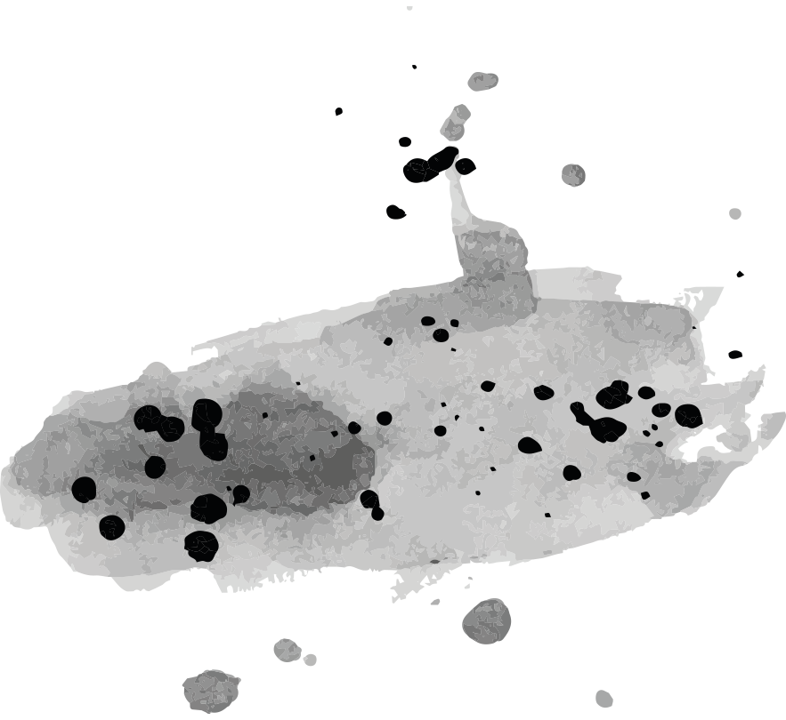
Word Formation
HS 513

Slide 2
What is Word Formation?
Word formation refers to the process of creating new words or forming existing words in a language.
It involves various methods, such as adding prefixes or suffixes, combining words, or altering the form of words

Slide 3
Contents
Affixation
Compounding
Conversion
Blending
Clipping
Coinage:
Borrowing
Back-formation
Acronyms
Onomatopoeia

Slide 4
Affixation
Definition: Affixation is a word formation process that involves adding prefixes, suffixes, or infixes to a base word to create a new word.
Mechanism: Affixes are attached to the base word without changing the grammatical category or meaning of the base word.
Example: In the word "unhappiness," the prefix "un-" and the suffix "-ness" are affixes added to the base word "happy" to create a new word.

Slide 5
Affixation
Prefix
Suffix
Prefixation is a type of affixation where a prefix is added to the beginning of a base word to modify its meaning or create a new word.
Suffixation is a type of affixation where a suffix is added to the end of a base word to alter its meaning or grammatical function.
Examples of Prefixation:
-er: Teacher (one who teaches)
-ful: Beautiful (full of beauty)
-tion: Information (act of informing)
-able: Comfortable (able to be comforted)
-ly: Quickly (in a quick manner)
Examples of Suffixation:
Un-: Unhappy (not happy)
Re-: Rewrite (write again)
Dis-: Disagree (not agree)
Pre-: Preheat (heat beforehand)
Mis-: Misunderstand (understand incorrectly)

Slide 6
prefix | meaning | examples
anti- | against/opposed to | anti-government, anti-racist, anti-war
auto- | self | autobiography, automobile
de- | reverse or change | de-classify, decontaminate, demotivate
dis- | reverse or remove | disagree, displeasure, disqualify
down- | reduce or lower | downgrade, downhearted
extra- | beyond | extraordinary, extraterrestrial
hyper- | extreme | hyperactive, hypertension
il-, im-, in-, ir- | not | illegal, impossible, insecure, irregular
inter- | between | interactive, international
mega- | very big, important | megabyte, mega-deal, megaton
mid- | middle | midday, midnight, mid-October
mis- | incorrectly, badly | misaligned, mislead, misspelt
non- | not | non-payment, non-smoking
over- | too much | overcook, overcharge, overrate
out- | go beyond | outdo, out-perform, outrun
post- | after | post-election, post-war
pre- | before | prehistoric, pre-war
pro- | in favour of | pro-communist, pro-democracy
re- | again | reconsider, redo, rewrite
semi- | half | semicircle, semi-retired
sub- | under, below | submarine, sub-Saharan
super- | above, beyond | super-hero, supermodel
tele- | at a distance | television, telepathic
trans- | across | transatlantic, transfer
ultra- | extremely | ultra-compact, ultrasound
un- | remove, reverse, not | undo, unpack, unhappy
under- | less than, beneath | undercook, underestimate
up- | make or move higher | upgrade, uphill

Slide 7
Suffix Meaning Example
-acy state or quality privacy, fallacy, delicacy
-al act or process of refusal, recital, rebuttal
-ance, -ence state or quality of maintenance, eminence, assurance
-dom place or state of being freedom, kingdom, boredom
-er, -or one who trainer, protector, narrator
-ism doctrine, belief communism, narcissism, skepticism
-ist one who chemist, narcissist, plagiarist
-ity, -ty quality of inactivity, veracity, parity, serenity
-ment condition of argument, endorsement, punishment
-ness state of being heaviness, sadness, rudeness, testiness
-ship position held fellowship, ownership, kinship, internship
-sion, -tion state of being concession, transition, abbreviation

Slide 8
Suffix | Meaning | Example
-ate | become | regulate, eradicate, enunciate, repudiate
-en | become | enlighten, awaken, strengthen
-ify, -fy | make or become | terrify, satisfy, rectify, exemplify
-ize, -ise* | become | civilize, humanize, socialize, valorize

Slide 9
Suffix | Meaning | Example
-able, -ible | capable of being | edible, presentable, abominable, credible
-al | pertaining to | regional, grammatical, emotional, coastal
-esque | reminiscent of | picturesque, statuesque, burlesque
-ful | notable for | fanciful, resentful, woeful, doubtful
-ic, -ical | pertaining to | musical, mythic, domestic, chiastic
-ious, -ous | characterized by | nutritious, portentous, studious
-ish | having the quality of | fiendish, childish, snobbish
-ive | having the nature of | creative, punitive, divisive, decisive
-less | without | endless, ageless, lawless, effortless
-y | characterized by | sleazy, hasty, greasy, nerdy, smelly

Slide 10
Compounding
Definition: Compounding is a word formation process where two or more words are combined to create a new word with a distinct meaning.
Mechanism: In compounding, individual words are joined together without changing their forms or meanings to form a single lexical unit.
Example: In the word "sunflower," the words "sun" and "flower" are compounded to create a new word with a specific meaning.

Slide 11
Types of Compound Words
Open Compound
First aid
Post office
Living room
High school
Ice cream
Closed compound
Bedroom
Keyhole
Football
Backspace
Armchair
Hyphenated compounds
In-depth
Snow-clad
One-footed
Sun-dried
Day-to-day

Slide 12
Permanent and Temporary Compounds
Permanent compound words are those that are already a part of the language; whereas, a temporary compound word is one that is formed to suit the writer’s or speaker’s requirement.
For example, words like first aid, grandmother, lawsuit, blackboard, etc. are permanent compound words which already exist in the English language
Words like red-headed, left-handed, bright-eyed, etc. are the kind of words that can be created to suit the requirement of the language user.

Slide 13
Match to form compunds
Sick | White
Written | Minded
Washed | Home
Hand | Well
Known | Broad
Hair | Lap
Half | Right
Card | Top
Handed | Cut
Flash | Sister

Slide 14
Conversion
Definition: Conversion, also known as zero derivation or functional shift, is a word formation process where a word changes its grammatical category without adding a morphological affix.
Mechanism: In conversion, a word shifts from one grammatical category to another without any overt changes in form. For example, a noun can become a verb, an adjective can become a noun, or a verb can become a noun.
Example: Noun to Verb: "hammer" (noun) becomes "to hammer" (verb).
Adjective to Noun: "green" (adjective) becomes "the green" (noun).
Verb to Noun: "run" (verb) becomes "a run" (noun).

Slide 15
More examples of conversion
Noun to Verb:
"book" (noun) -> "to book" (verb)
"ship" (noun) -> "to ship" (verb)
Adjective to Noun:
"fast" (adjective) -> "the fast" (noun)
"old" (adjective) -> "the old" (noun)
Verb to Noun:
"play" (verb) -> "a play" (noun)
"sing" (verb) -> "a sing" (noun)
Noun to Adjective:
"gold" (noun) -> "gold jewelry" (adjective)
"stone" (noun) -> "stone wall" (adjective)
Adjective to Verb:
"sharp" (adjective) -> "to sharpen" (verb)
"bright" (adjective) -> "to brighten" (verb)
Verb to Adjective:
"jump" (verb) -> "a jumping contest" (adjective)
"swim" (verb) -> "a swimming pool" (adjective)

Slide 16
Blending
Definition: Blending is a word formation process where parts of two or more words are combined to create a new word that retains some features of the original words.
Mechanism: In blending, portions of words are fused together, often at the boundaries where they overlap, to form a single, compact word.
Example:"Brunch" is a blend of "breakfast" and "lunch."
"Smog" is a blend of "smoke" and "fog."
"Infomercial" is a blend of "information" and "commercial."

Slide 17
Clipping
Definition: Clipping is a word formation process where a word is shortened by removing one or more syllables to create a new, abbreviated form.
Mechanism: Clipping involves truncating a word while retaining its meaning or part of its original form. Clipped words often maintain their original pronunciation.
Example:"Phone" is a clipped form of "telephone."
"Ad" is a clipped form of "advertisement."
"Gym" is a clipped form of "gymnasium."

Slide 18
Coinage
Definition: Coinage, also known as neologism, is a word formation process where a completely new word is created, often without deriving it from existing words or roots.
Mechanism: Coinage involves inventing a word from scratch, typically to label a new concept, product, or phenomenon. These words are often coined based on sound symbolism, combination of sounds, or entirely novel formations.
Example:"Google" was coined as a company name, now commonly used as a verb meaning to search for information online.
"Kleenex" is a brand name that became a generic term for facial tissues.
"Podcast" is a blend of "iPod" and "broadcast," created to describe digital audio content.

Slide 19
Borrowing
Definition: Borrowing is a word formation process where a word is adopted from one language and incorporated into another language with little or no modification.
Mechanism: Borrowing involves importing words from one language into another due to cultural exchange, trade, or historical interactions. Borrowed words often retain their original form and meaning.
Example:"Piano" was borrowed from Italian into English.
"Taco" was borrowed from Spanish into English.
"Sushi" was borrowed from Japanese into English.

Slide 20
Back-Formation
Definition: Back-formation is a word formation process where a new word is created by removing an affix (such as a suffix or prefix) from an existing word, often mistakenly perceived as the base or root word.
Mechanism: Back-formation involves the reanalysis of a word to create a new word that appears to be the base form from which the original word was derived. This process typically occurs when a word is incorrectly perceived as having an affix.
Example:"Edit" was back-formed from "editor."
"Donate" was back-formed from "donation."
"Televise" was back-formed from "television."

Slide 21
Acronym
Definition: An acronym is a word formed from the initial letters or parts of a series of words, with each letter representing one of the words in the sequence.
Mechanism: Acronyms are created by taking the initial letters of a phrase or series of words and combining them to form a new word. Acronyms are pronounced as words rather than individual letters.
Example:"NASA" stands for National Aeronautics and Space Administration.
"UNICEF" stands for United Nations International Children's Emergency Fund.
"RADAR" stands for Radio Detection and Ranging.

Slide 22
Onomatopoeia
Definition: Onomatopoeia is a word formation process where a word imitates the sound it represents. In other words, the word sounds like the noise it describes.
Mechanism: Onomatopoeic words are created by mimicking natural sounds, actions, or phenomena through language. These words often evoke auditory sensations and enhance the vividness of descriptions.
Example:"Buzz" imitates the sound of a bee.
"Meow" imitates the sound of a cat.
"Crash" imitates the sound of a collision.

Slide 23
Borrowing
French
Law
Aristocracy
Cooking
Latin
Greek

Slide 24
Fun Fact
Words
"Bedazzled"
"Swagger"
"Lonely"
"Gloomy"
"Laughable"
"Moonbeam"
"Sanctimonious"
"Puke"
And some common phrases:
"Wild-goose chase"
"In a pickle"
"Break the ice"
"Heart of gold"
"Fair play"
"Eyeball"
William Shakespeare is credited with inventing or popularizing a vast number of words and phrases that are still in common use today.
Some estimates suggest that Shakespeare introduced over 1,700 words into the English language!

Slide 25
Stay Tuned…

